Slide 1
Mental Disorder Detection for Schizophrenia Patients via Deep Visual Perception 透過深度視覺感知偵測思覺失調症患者的精神異常
研究生 ： 林炳彰
指導教授： 傅立成 博士
國立臺灣大學電機工程研究所
Notes:
各位口試委員好,
我是研究生：林炳彰
指導教授是傅立成博士
口試題目為“透過深度視覺感知偵測思覺失調症患者的精神異常”

Slide 2
Outline
Introduction
System Overview
Methodology
Experiments
Conclusions
Notes:
這是今天的介紹大綱，將會依序為各位介紹

Slide 3
Outline
Introduction
Background
Motivation
Objective & Challenges
Related Works
System Overview
Methodology
Experiments
Conclusions
Notes:
首先是“引言”的部分，
在這章節中，我會依序介紹
1. 研究背景
2. 研究動機
3. 研究目標與挑戰
4. 相關文獻

Slide 4
Introduction – Background (1 / 2)
Schizophrenia [1] requires more attentions
It is a mental illness that will progressively change a person's mental state and cause serious social problems [1, 2].
Patients are unable to express their real thinking ordinarily. Also, their behaviors are often different from someone else’s.
Its symptoms can be divided into:
Negative [3 - 5]: flat affect, alogia, asociality, anhedonia, and avolition
Positive [5]: hallucinations, delusions, and disorganized speech
[1] M. Owen, A. Sawa and P. Mortensen, “Schizophrenia,” The Lancet, vol. 388, no. 10039, pp. 86-97, 2016.
[2] P. Stępnicki, M. Kondej and A. Kaczor, “Current Concepts and Treatments of Schizophrenia,” Molecules, vol. 23, no. 8, p. 2087, 2018.
[3] M. Adida, J. Azorin, R. Belzeaux and E. Fakra, “Negative Symptoms: clinical and psychometric aspects,” L’Encephale, vol. 41, no. 6, pp. 6S15-6S17, 2015.
[4] C. Mach and S. Dollfus, “Scale for Assessing Negative Symptoms in Schizophrenia: A Systematic Review,” L’Encephale, vol. 42, no. 2, pp. 165-171, 2016.
[5] Diagnostic and statistical manual of mental disorders. Washington (D.C.): American Psychiatric Publishing, 2013.
Notes:
思覺失調症為一種心理疾病，
病患會因為心理上的異常而無法正常工作，這將容易造成社會資源的耗損。
病患沒有辦法正常的表達他們的真實想法。並且，他們在行為上也與他人有所不同。
思覺失調的症狀可以被分為
負性與正性
負性指的是“情緒反應較少，不易從行為與情緒觀察出來”
正性指的是“情緒反應是外顯的，可以從整體外觀觀察出來”

Slide 5
Introduction – Background (2 / 2)
According to the medical literature [5, 6] about mental illness, the mental disorder of schizophrenia can be described as Bipolar disorder and Depression disorder.
Bipolar disorder is an unstable emotional condition characterized by abnormal cycles, persistent high mood and low mood.
Depression disorder is a low emotional state.
These disorders are highly related to emotion and depression.
Previous studies have been extensively discussed facial analysis to infer the mental state of human.
Emotion Recognition
Depression Estimation
[5] Diagnostic and statistical manual of mental disorders. Washington (D.C.): American Psychiatric Publishing, 2013.
[6] ICD-10. Geneva: World Health Organization, 2004.
Notes:
根據DSM-5與ICD-10，我們可以藉由Bipolar disorder和Depression disorder。
Bipolar: 是一種不穩定的情緒狀況，情緒波動較大。
Depression: 是一種情緒低落的狀態。
由於這些症狀皆與情緒和抑鬱高度相關。
因此先前的研究透過面部分析以推斷人類的心理狀態，進一步偵測人們的心理異常。
Emotion Recognition
Depression Estimation

Slide 6
Introduction – Motivation (1 / 3)
Conventional methods based on facial analysis often fail to infer the mental state of people.
Emotional signals from the face are indistinguishable and ambiguous.
The facial expressions of schizophrenia patients are not discriminative enough.
The influence of antipsychotic medication [1]
The nature of schizophrenia [1, 3 – 6]
The emotion is reflected through the face and context [7]
People identify the emotion of others from not only their faces but also surrounding contexts [8, 9]
[7] A. Kring and T. Campellone, “Emotion Perception in Schizophrenia: Context Matters,” in Emotion Review, vol. 4, no. 2, pp. 182-186, 2012.
[8] Lisa Feldman Barrett, Batja Mesquita, and Maria Gendron, “Context in emotion perception,” in Curr. Dir. in Psych. Science, 2011.
[9] Elissa M Aminoff, Kestutis Kveraga, and Moshe Bar. “The role of the parahippocampal cortex in cognition,” in Trends in cognitive sciences, 2013.
Notes:
由於面部表情的模糊特性，基於面部分析的傳統方法常會無法準確的推估人的心理狀態
由於藥物的作用與症狀本身的特質，思覺失調症患者的面部表情不具備足夠的辨別性
在認知科學方面的研究亦表明
情緒會經由臉部與景況所流露出來
人們識別他人的情緒時，不單只考慮面部，還會考慮周遭景況
在這裏context指的是人的肢體語言、動作與跟他人的互動

Slide 7
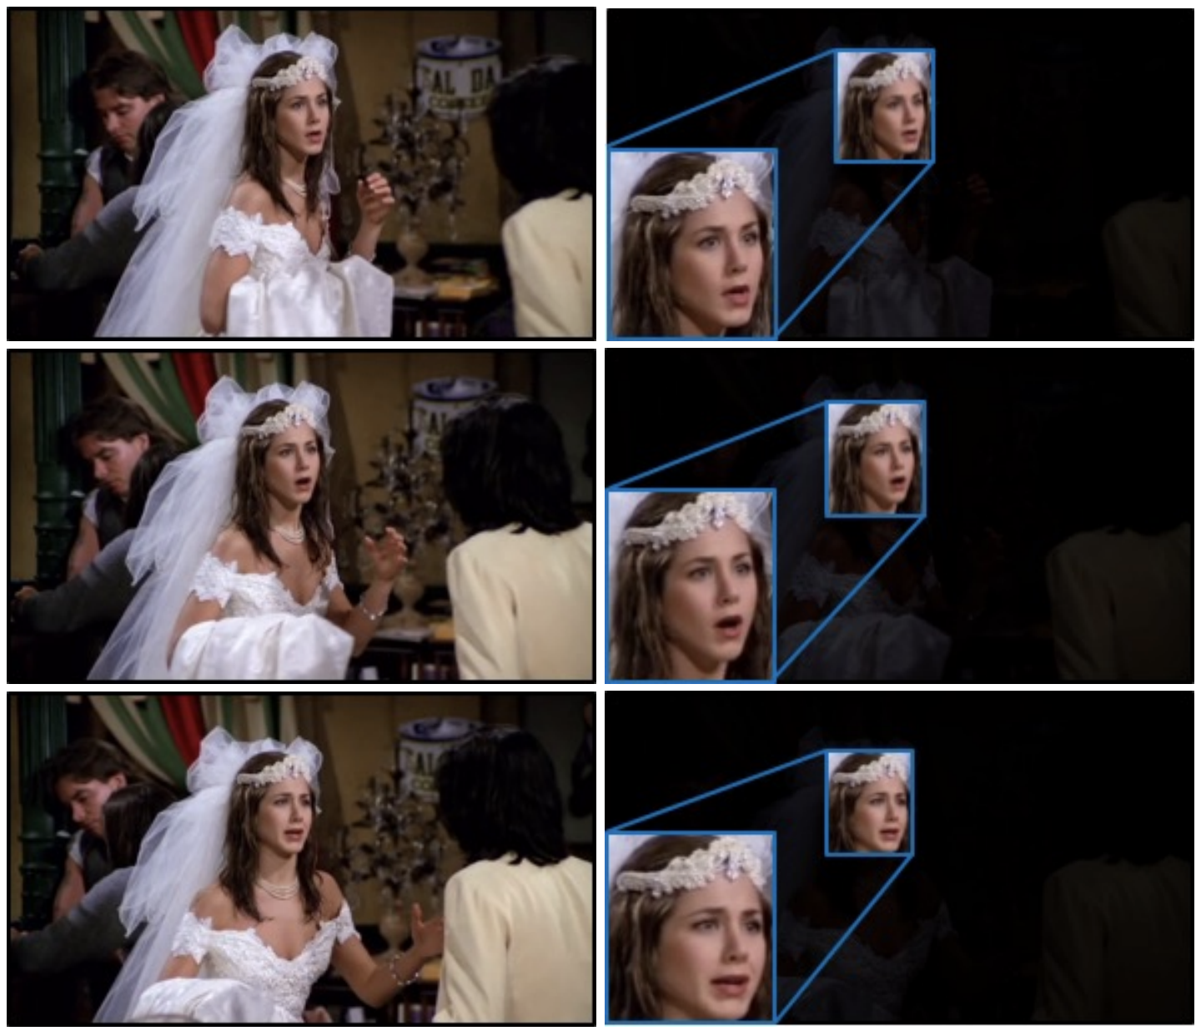
Introduction – Motivation (2 / 3)
Context & Face
Cropped Face
Context & Face | Face only
Surprise | Anger
Surprise | Surprise
Surprise | Sad
[10]
[10] J. Lee, S. Kim, S. Kim, J. Park and K. Sohn, “Context-Aware Emotion Recognition Networks,” in 2019 IEEE/CVF International Conference on Computer Vision (ICCV), Seoul, Korea (South), pp. 10142-10151, 2019.

Slide 8
Introduction – Motivation (3 / 3)
Some symptoms are related to depressive ones [1, 3 - 6]
Patients with depression yield less favorable therapy courses and poorer outcomes
Recording of entire emotional status and depressive level presents the mental state of patients.
It is an important reference for doctors to diagnose mental illness.
It is a useful recording for psychologists to consult with patients.
Notes:
一些症狀與憂鬱有關，並且病患常常導致較差的預後。
記錄整個情緒狀態和抑鬱水平可顯示患者的精神狀態。
它是醫生診斷精神疾病的重要參考。
這是心理學家諮詢患者的有用記錄。

Slide 9
Introduction – Objective & Challenges (1 / 2)
Our objective is to design a mental disorder detection system for schizophrenia patients.
Learning part: learn models to precisely infer the mental state of people
Emotion recognition
Depression estimation
Inference part: follow the medical literature about mental illness [5-6] and human behaviors [7-9] to detect the mental disorders based on the predicted mental state.
Bipolar disorder
Depression disorder

Slide 10
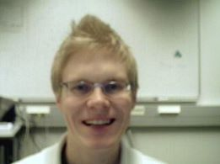

Introduction – Objective & Challenges (2 / 2)
Emotion recognition and depression estimation suffer from
Illumination
Noise
Indistinguishable and ambiguous emotion signals
Learning the depression model may lead to longer training procedure.
Normal illumination
Weak illumination
Ambiguous emotion signals
[11]
[10]
[10] G. Zhao, and M. Pietikainen, “Dynamic texture recognition using local binary patterns with an application to facial expressions,” IEEE Transactions on Pattern Analysis and Machine Intelligence, 2007.

Slide 11
Introduction – Related Works (1 / 2) Emotion Recognition
Method | Mode | Input | Computational Cost | Stability | Multi-task
SCN [12] | Image | Face | Low | Low | False
EMOTIC [13] | Image | Face and Body | Low | Low | False
EmotiCon [14] | Video | Face, Body, and Depth | High | Low | False
CAER [10] | Video | Face and Context | High | High | False
Ours | Video | Face and Context | Low | High | True
[10] J. Lee, S. Kim, S. Kim, J. Park and K. Sohn, “Context-Aware Emotion Recognition Networks,” in 2019 IEEE/CVF International Conference on Computer Vision (ICCV), Seoul, Korea (South), pp. 10142-10151, 2019.
[12] K. Wang, X. Peng, J. Yang, S. Lu and Y. Qiao, “Suppressing Uncertainties for Large-Scale Facial Expression Recognition,” in 2020 IEEE/CVF Conference on Computer Vision and Pattern Recognition (CVPR), Seattle, WA, USA, pp. 6896-6905, 2020.
[13] R. Kosti, J. M. Alvarez, A. Recasens and A. Lapedriza, “EMOTIC: Emotions in Context Dataset,” in 2017 IEEE Conference on Computer Vision and Pattern Recognition Workshops (CVPRW), Honolulu, HI, pp. 2309-2317, 2020.
[14] T. Mittal, P. Guhan, U. Bhattacharya, R. Chandra, A. Bera and D. Manocha, “EmotiCon: Context-Aware Multimodal Emotion Recognition Using Frege’s Principle,” in 2020 IEEE/CVF Conference on Computer Vision and Pattern Recognition (CVPR), Seattle, WA, USA, pp. 14222-14231, 2020.

Slide 12
Introduction – Related Works (2 / 2) Depression Estimation
Method | Mode | Input | Computational Cost | Stability | Multi-task
InaoeBuap [15] | Image | Face | Low | Low | False
BU-CMPE [16] | Video | Face | Low | Low | False
DCNN [17] | Video | Face | High | High | False
RNN-C3D [18] | Video | Face | High | High | False
Ours | Video | Face and Context | Low | High | True
[15] H. Espinosa, H. Escalante, L. Pineda, M. Montes-y-Gómez, D. Pinto, and V. Reyes-Meza, “Fusing Affective Dimensions and Audio-Visual Features from Segmented Video for Depression Recognition: INAOE-BUAP's Participation at AVEC'14 Challenge,” in AVEC '14, 2014.
[16] H. Kaya, F. Çilli, and A. A. Salah, “Ensemble CCA for Continuous Emotion Prediction,” in AVEC '14, 2014.
[17] Y. Zhu, Y. Shang, Z. Shao, and G. Guo, “Automated Depression Diagnosis Based on Deep Networks to Encode Facial Appearance and Dynamics,” IEEE Transactions on Affective Computing, vol. 9, pp. 578-584, 2018.
[18] M. A. Jazaery and G. Guo, “Video-Based Depression Level Analysis by Encoding Deep Spatiotemporal Features,” IEEE Transactions on Affective Computing, pp. 1-1, 2018.

Slide 13
Outline
Introduction
System Overview
Methodology
Experiments
Conclusions

Slide 14
System Overview
Our system consists of two parts
Learning:
Design a multi-task learning framework to learn a model to precisely infer the human’s mental state.
Detection:
Follow some studies [7-9] about cognitive science and the medical literature about mental illness [5-6] to detect mental disorders for schizophrenia patients.
System
Learning
Detection

Slide 15
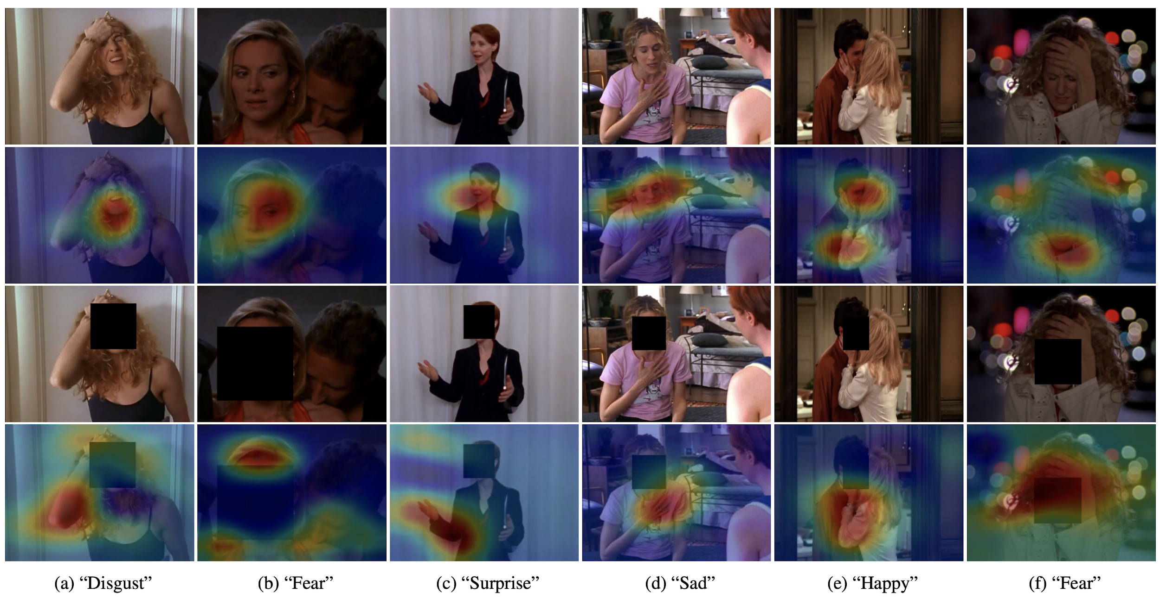

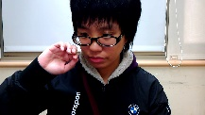


System Overview
Learning
Detection
Emotion Recognition
Density Loss
Face
…
Face Encoder
CMGCN
Metric Learning
Patient’s video
Classifier
A-Softmax Loss
Emotion Recognition
Depression Estimation
Context
Context Encoder
Inference
Mean Passer
Recording Predictions
Depression Estimation
MSE
Loss
Analysis Abnormal Mental Patterns
Face
Face Encoder
CMGCN
Regressor
Distributed
Loss
Output Results
Context
Context Encoder
CMGCN: Cross-Modality Graph Convolutional Network

Slide 16
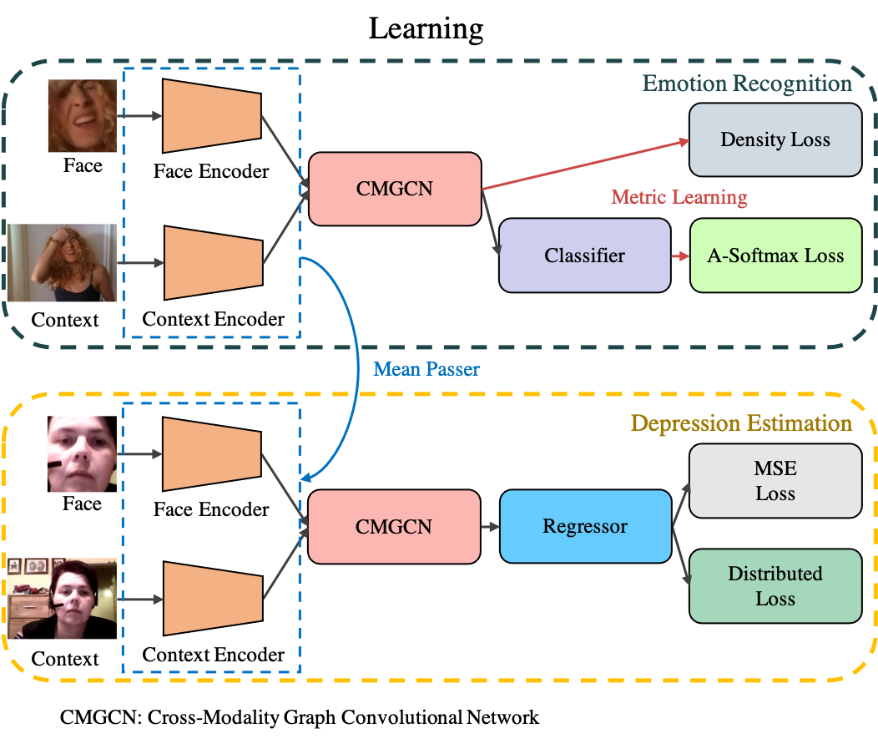
System Overview - Multi-task Learning
For the learning part, we design three modules to constitute a multi-task learning framework.
Cross-modality Graph Convolutional Network (CMGCN)
Task-aware Objective Functions
Density Loss
Distributed Loss
Mean Passer

Slide 17
Outline
Introduction
Framework Overview
Methodology
Multi-task Learning framework
Cross-Modality Graph Convolutional Network (CMGCN)
Task-Aware Objective Functions
Mean Passer for Knowledge Transfer
Mental Disorder Detection
Experiments
Conclusions

Slide 18
Multi-task Learning Framework
CMGCN: Cross-Modality Graph Convolutional Network
Emotion Recognition
Density Loss
Face
Face Encoder
CMGCN
Metric Learning
Classifier
A-Softmax Loss
Context
Context Encoder
Mean Passer
Depression Estimation
MSE
Loss
Face
Face Encoder
CMGCN
Regressor
Distributed
Loss
Context
Context Encoder

Slide 19
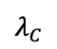
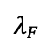
CMGCN – Introduction (1 / 4)
CAER-Net [10] consider a separate scheme to integrate the visual features from the face and context.
Combine with the wrong weight
Include much irrelevant information, such as background pixels
3D CNN
Linear
$$λ_{F}$$
Face feature
C
3D CNN
Linear
$$λ_{C}$$
Final representation
Context feature
C
Concatenate
Multiply
Global Average Pooling (GAP)

Slide 20
CMGCN – Introduction (2 / 4)
GAP: Global Average Pooling
GAP consider all pixels of the given feature maps
Include many background pixels.
Require to tune all related parameters in the networks.
Average all pixels
Backward
3D CNN
3D CNN
Context feature map
Face feature map

Slide 21
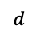

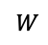
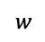
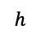
CMGCN – Introduction (3 / 4)
CMGCN takes the graph viewpoint to model the pixel-wise correlation between modalities to alleviate the above-mentioned problems.
$$d$$
$$w$$
Sampling Scheme
GCN
Embedding
$$h$$
Cross-Modality Affinity Graph
C
Face feature map
Sampling Scheme
GCN
Embedding
$$d$$
$$w$$
Final representation
$$W$$
$$h$$
Element-wise addition
C
Concatenate
Context feature map
Global Average Pooling (GAP)
GCN: Graph Convolutional Network

Slide 22
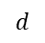
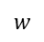
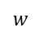
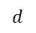
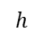
CMGCN – Introduction (4 / 4)
Cross-Modality Graph Convolutional Network (CMGCN)
Build an cross-modality affinity graph
Impose sampling scheme
Integrate features
Element-wise addition
C
Concatenate
Global Average Pooling (GAP)
GCN: Graph Convolutional Network
$$d$$
$$w$$
Sampling Scheme
GCN
Embedding
Sampling Scheme
GCN
Embedding
$$h$$
Cross-Modality Affinity Graph
Cross-Modality Affinity Graph
C
C
Face feature map
Sampling Scheme
GCN
Embedding
Sampling Scheme
GCN
Embedding
$$d$$
$$w$$
Final representation
$$h$$
Context feature map

Slide 23
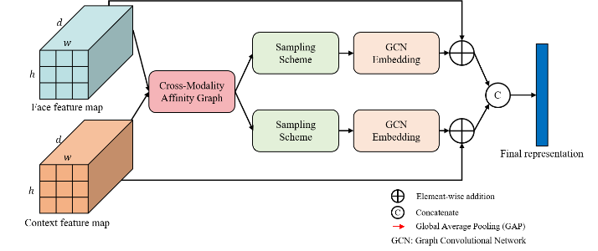
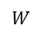
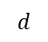
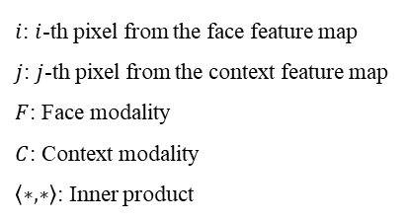
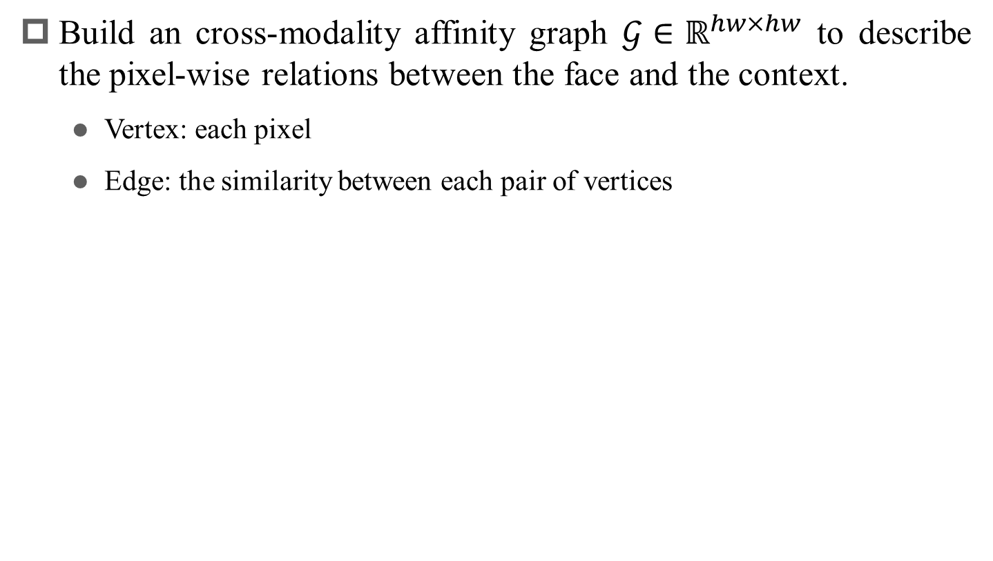
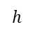
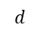
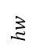
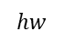
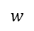
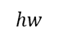
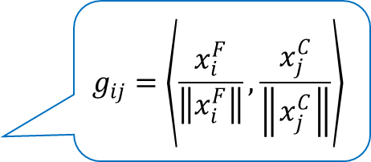
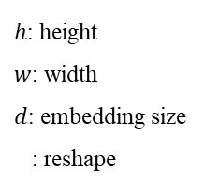
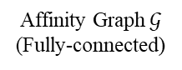
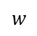
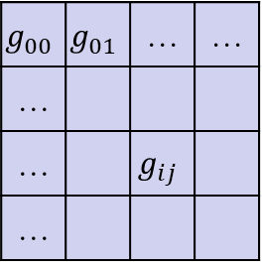
CMGCN – Approach (1 / 5)
Build an cross-modality affinity graph $𝒢∈ℝ^{hw×hw}$ to describe the pixel-wise relations between the face and the context.
Vertex: each pixel
Edge: the similarity between each pair of vertices
$h$: height
$w$: width
$d$: embedding size
: reshape
$$d$$
$$hw$$
$$w$$
$$d$$
$$hw$$
$$h$$
$$g_{00}$$ | $$g_{01}$$ | … | …
…
… |  | $$g_{ij}$$
…
$$g_{ij}=\left\langle \frac{x_{i}^{F}}{\left\|x_{i}^{F}\right\|}, \frac{x_{j}^{C}}{\left\|x_{j}^{C}\right\|}\right\rangle$$
Face feature map
Cosine-similarity
$$hw$$
$$d$$
$$hw$$
$$w$$
$i$: $i$-th pixel from the face feature map
$j$: $j$-th pixel from the context feature map
$F$: Face modality
$C$: Context modality
$\left\langle ∗,∗\right\rangle$: Inner product
$$W$$
$$d$$
Affinity Graph $𝒢$
(Fully-connected)
$$h$$
Context feature map
Notes:
右上角放一張overall的CMGCN，然後標出目前在講overall的哪個部分。
說明清楚computational cost是指training時，或其定義。
標出cosine-similarity的數學式。

Slide 24
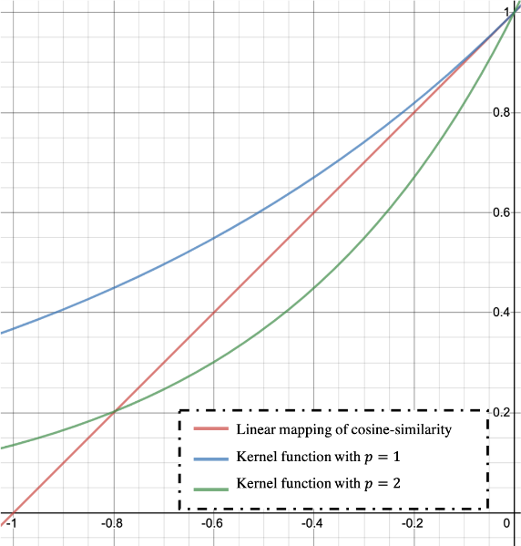
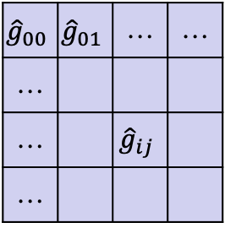
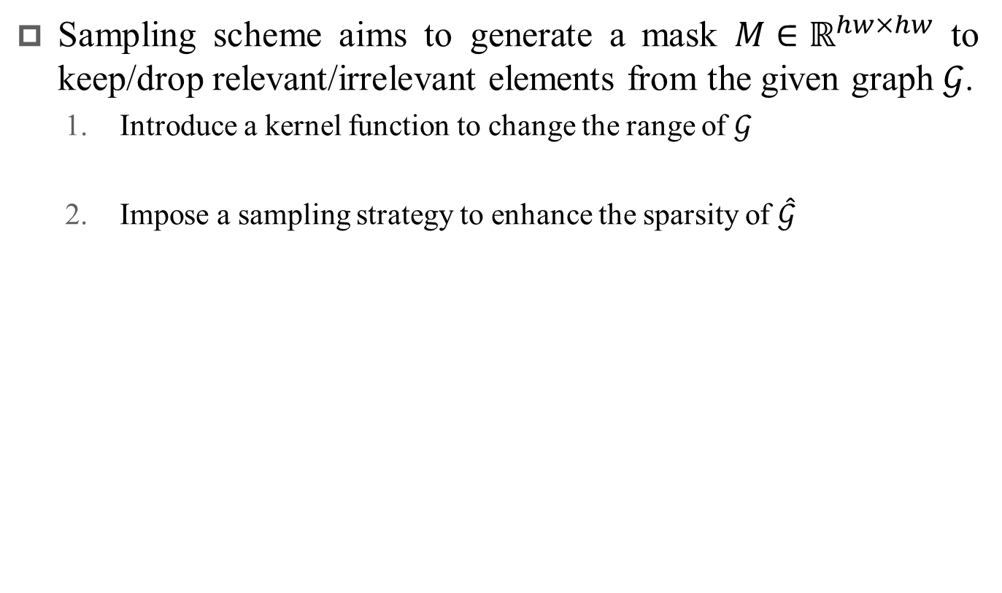
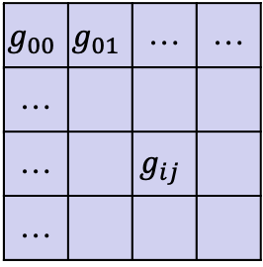
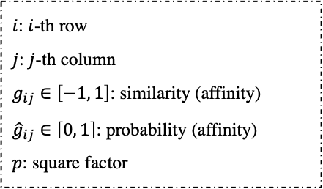
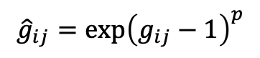
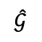
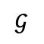
CMGCN – Approach (2 / 5)
Sampling scheme aims to generate a mask $M∈ℝ^{hw×hw}$ to keep/drop relevant/irrelevant elements from the given graph $𝒢$.
Introduce a kernel function to change the range of $𝒢$
Impose a sampling strategy to enhance the sparsity of $\hat{𝒢}$
$i$: $i$-th row
$j$: $j$-th column
$g_{ij}∈\left[−1, 1\right]$: similarity (affinity)
${\hat{g}}_{ij}∈\left[0, 1\right]$: probability (affinity)
$p$: square factor
$${\hat{g}}_{ij}={exp⁡\left(g_{ij}−1\right)}^{p}$$
$$g_{00}$$ | $$g_{01}$$ | … | …
…
… |  | $$g_{ij}$$
…
$${\hat{g}}_{00}$$ | $${\hat{g}}_{01}$$ | … | …
…
… |  | $${\hat{g}}_{ij}$$
…
Kernel
function
Cosine-similarity
Probability
$$𝒢$$
$$\hat{𝒢}$$

Slide 25
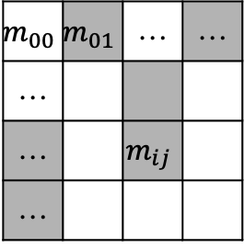
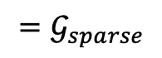
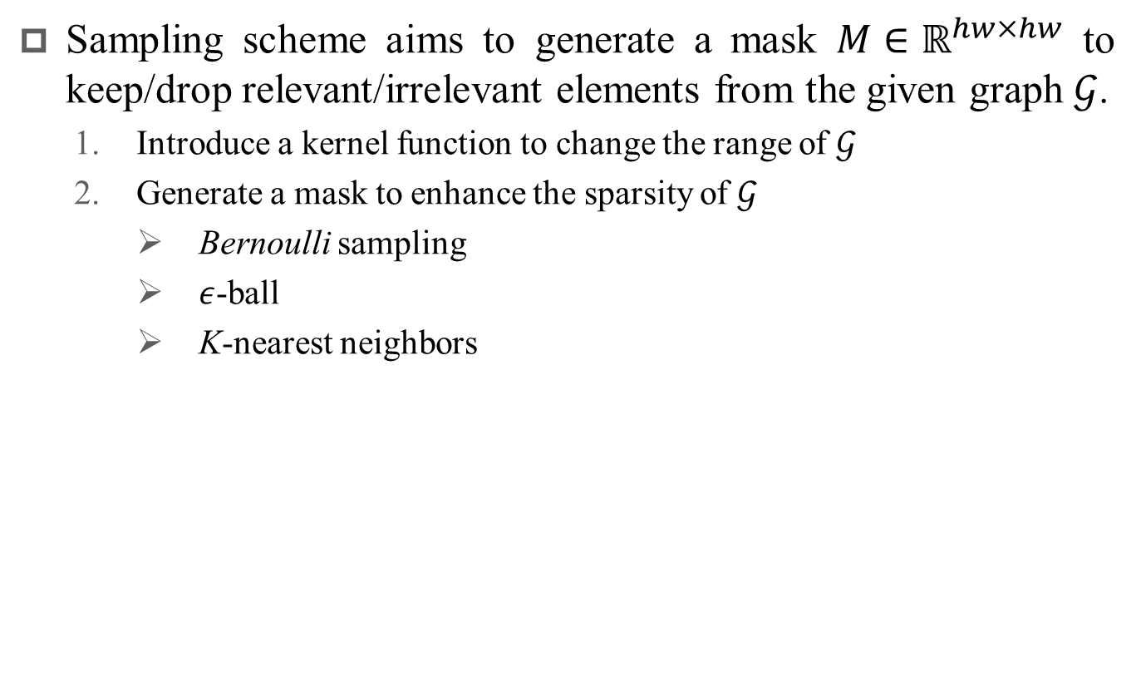
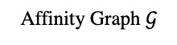
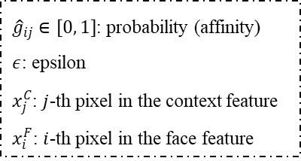
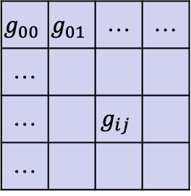
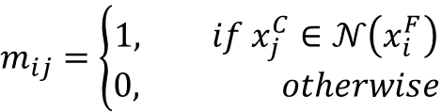
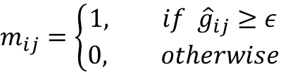
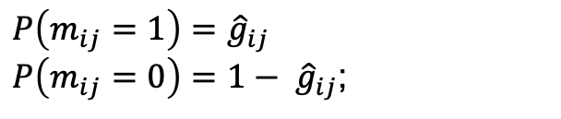

CMGCN – Approach (3 / 5)
Sampling scheme aims to generate a mask $M∈ℝ^{hw×hw}$ to keep/drop relevant/irrelevant elements from the given graph $𝒢$.
Introduce a kernel function to change the range of $𝒢$
Generate a mask to enhance the sparsity of $𝒢$
Bernoulli sampling
$ε$-ball
K-nearest neighbors
${\hat{g}}_{ij}∈\left[0, 1\right]$: probability (affinity)
$ε$: epsilon
$x_{j}^{C}$: $j$-th pixel in the context feature
$x_{i}^{F}$: $i$-th pixel in the face feature
$P\left(m_{ij}=1\right)=$ ${\hat{g}}_{ij}$
$P\left(m_{ij}=0\right)=$ ${1− \hat{g}}_{ij}$;
$$g_{00}$$ | $$g_{01}$$ | … | …
…
… |  | $$g_{ij}$$
…
$$m_{00}$$ | $$m_{01}$$ | … | …
…
… |  | $$m_{ij}$$
…
$$=𝒢_{sparse}$$
$$m_{ij}=\left\{\begin{aligned}1, if {\hat{g}}_{ij}≥ε \\ 0, otherwise\end{aligned}\right.$$
$$m_{ij}=\left\{\begin{aligned}1, if x_{j}^{C}∈𝒩\left(x_{i}^{F}\right) \\ 0, otherwise\end{aligned}\right.$$
Affinity Graph $𝒢$
Mask $M$
Element-wise multiply

Slide 26
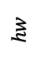




CMGCN – Approach (4 / 5)
$𝒢$: affinity graph
$\hat{𝒢}$: normalized graph
$D$: diagonal degree matrix of $\hat{𝒢}$
$X$: features
$W$: embedding
$σ$: activation function
$h$: height
$w$: width
Integrate visual features
Graph Convolutional Networks (GCN) [19]
Bidirectional Fusion
$$D_{ii}=\sum_{i=1}^{hw}{g_{ij}}$$
$$\hat{𝒢}=D^{−1}𝒢$$
$X_{𝒢}=σ\left(\hat{𝒢}XW\right)$
Correlation
between the face and the context
$$hw$$
matrix multiplication
$$hw$$
Sparse graph $𝒢_{s}$
Modality feature
Embedding
[19] T. Kipf, and M. Welling, “Semi-Supervised Classification with Graph Convolutional Networks,” in International Conference on Learning Representations (ICLR), 2017.

Slide 27








CMGCN – Approach (5 / 5)
$𝒢_{s}^{C2F}$: sparse graph (context to face)
$𝒢_{F2C}$: sparse graph (face to context)
$X_{F}$: face feature
$X_{C}$: context feature
$W_{F}$: graph embedding for face
$W_{C}$: graph embedding for context
$σ$: activation function
${\hat{𝒢}}_{F2C}$: normalized graph (face to context)
${\hat{𝒢}}_{C2F}$: normalized graph (context to face)
${\hat{X}}_{𝒢}^{F}$: graph feature of face feature
${\hat{X}}_{𝒢}^{C}$: graph feature of context feature
$\left[∗, ∗\right]$: concatenation
$X_{final}$: final representation
Integrate visual features
Graph Convolutional Networks (GCN) [19]
Bidirectional Fusion
Element-wise addition
C
Concatenate
Global Average Pooling (GAP)
Face feature
GCN: Graph Convolutional Network
GCN
Embedding
Face Modality (Query)
Face Modality (Gallery)
Sparse graph $𝒢_{s}^{C2F}$
C
GCN
Embedding
$${\hat{X}}_{𝒢}^{F}=GAP\left(σ\left(𝒢_{s}^{C2F}X_{F}W_{F}\right)\right)$$
$${\hat{X}}_{𝒢}^{C}=GAP\left(σ\left(𝒢_{s}^{F2C}X_{C}W_{C}\right)\right)$$
$$X_{final}=\left[{\hat{X}}_{𝒢}^{F},{\hat{X}}_{𝒢}^{C}\right]$$
Sparse graph $𝒢_{s}^{F2C}$
Final
representation
Context Modality (Gallery)
Context Modality (Query)
Context feature
[19] T. Kipf, and M. Welling, “Semi-Supervised Classification with Graph Convolutional Networks,” in International Conference on Learning Representations (ICLR), 2017.

Slide 28
Outline
Introduction
Framework Overview
Methodology
Cross-Modality Graph Convolutional Network (CMGCN)
Task-Aware Objective Functions
Density Loss for Emotion Recognition (Classification Task)
Distributed Loss for Depression Estimation (Regression Task)
Mean Passer for Knowledge Transfer
Mental Disorder Detection
Experiments
Conclusions

Slide 29
Multi-task Learning Framework
CMGCN: Cross-Modality Graph Convolutional Network
Emotion Recognition
Density Loss
Face
Face Encoder
CMGCN
Metric Learning
Classifier
A-Softmax Loss
Context
Context Encoder
Mean Passer
Depression Estimation
MSE
Loss
Face
Face Encoder
CMGCN
Regressor
Distributed
Loss
Context
Context Encoder

Slide 30

Task-aware objective functions
Our multi-task learning includes
Classification (emotion recognition)
Regression (depression estimation)
The nature of each task is quite different.
We thus design task-aware objective functions to achieve better model convergence for each task.
Density Loss for emotion recognition
Distributed Loss for depression estimation

Slide 31
Outline
Introduction
Multi-task Learning for Mental Disorder Detection
Cross-Modality Graph Convolutional Networks
Task-Aware Objective Functions
Density Loss for Emotion Recognition (Classification Task)
Distributed Loss for Depression Estimation (Regression Task)
Mean Passer for Knowledge Transfer
Mental Disorder Detection
Experiments
Conclusions

Slide 32
Emotion Recognition
Emotion recognition is a classification task
Learn an embedding with high inter-class separability and intra-class compactness
High intra-class
compactness
Metric learning
…
…
representation
High inter-class
separability
Original embedding space
Learned embedding space

Slide 33



Density Loss (1 / 3)
We consider the orthogonal relation and embedding density to form a regularization for embedding learning.
$$b_{p}$$
Mapping to Hyper-sphere
1
$$b_{n}$$
> m
0
Anchor
Angular measurement
(cosine-similarity)

Slide 34
Density Loss (2 / 3)
We consider the orthogonal relation and embedding density to form a regularization for embedding learning.
Boundary
Density field

Slide 35





Density Loss (3 / 3)
Density term:
Orthogonal relations:
Overall loss:
$i$: i-th anchor
$i$: j-th sample
$s_{ij}$: similarity between i (anchor) and j (sample)
$n$: batch size
$μ_{i}^{p}=\sum_{j=1, y_{i}=y_{j}}^{n}{s_{ij}}$: mean of intra-class pairs
$μ_{i}^{n}=\sum_{j=1, y_{i}≠y_{j}}^{n}{s_{ij}}$: mean of inter-class pairs
${\left[∙\right]}_{+}$: $max\left(x,0\right)$ hinge loss
$b_{p}$: intra-class boundary
$b_{n}$: inter-class boundary
$p$: norm value
$$where b_{p}=1−b_{n}$$
Notes:
註解hinge loss

Slide 36
Outline
Introduction
Multi-task Learning for Mental Disorder Detection
Cross-Modality Graph Convolutional Networks
Task-Aware Objective Functions
Density Loss for Emotion Recognition (Classification Task)
Distributed Loss for Depression Estimation (Regression Task)
Mean Passer for Knowledge Transfer
Mental Disorder Detection
Experiments
Conclusions

Slide 37




Depression Estimation
Depression estimation is a regression task.
Learn to predict a precise regression score
Adopt Mean Square Error (MSE) loss for optimization
MSE loss may not refine the intensity of the loss properly
Exploit square operation to enlarge the penalty
MSE loss:
$$ℒ_{MSE}=\frac{1}{n}\sum_{i=1}^{n}{{\left(y_{i}−{\hat{y}}_{i}\right)}^{2}}$$
$n$: batch size
$y_{i}$: ground-truth
${\hat{y}}_{i}$: prediction
$$<1$$

Slide 38

Distributed Loss (1 / 3)
MLP: Multi-Layer Perceptron
We take the classification viewpoint to refine the loss value.
According to the regression targets $0…n$, we separate the prediction into $\left(n+1\right)+1$ bins.
MLP with $\left(n+2\right)$neurons to predict the likelihood
Regression Targets: [0, 1, 2, 3, 4, …, n]
Divide into n + 2 bins
Likelihood
Target
BDI-II Score | Depression Severity
0 - 13 | None
14 - 19 | Mild
20 - 28 | Moderate
29 - 45 | Severe
…
n+2 bins
[19]
0
1
2
3
4
5
6
n
n+1
[19] A. Beck, R. Steer, R. Ball, and W. Ranieri, "Comparison of Beck Depression Inventories -IA and -II in psychiatric outpatients," Journal of personality assessment, vol. 67 3, pp. 588-97, 1996.

Slide 39


Distributed Loss (2 / 3)
Maximize the predictions of bins corresponding to the target score.
$$ℒ=\frac{1}{n}\sum_{i=1}^{n}{\left[−\log\left(s_{y_{i}}\right)−\log\left(s_{y_{i}+1}\right)\right]}$$
$n$: batch size
$s_{y_{i}}$: prediction of the target bin
$s_{y_{i}+1}$: prediction of the target bin
Likelihood
Maximize
…
n+2 bins
0
1
2
3
4
5
6
n
n+1

Slide 40
Distributed Loss (3/ 3)
MLP: Multi-Layer Perceptron
Learning scheme
Separate
Joint
MLP
MSE Loss
MSE Loss
CNN
CNN
Distributed Loss
(N+1 bins)
MLP
Distributed Loss
Last layer of MLP
Separate Scheme
Joint Head
Notes:
要講自己最後是用哪一個

Slide 41
Outline
Introduction
Multi-task Learning for Mental Disorder Detection
Cross-Modality Graph Convolutional Networks
Task-Aware Objective Functions
Density Loss for Emotion Recognition (Classification Task)
Distributed Loss for Depression Estimation (Regression Task)
Mean Passer for Knowledge Transfer
Mental Disorder Detection
Experiments
Conclusions

Slide 42


Mean Passer
Depression is an extension of emotion.
Consider Exponential Moving Average (EMA) to smoothly transfer the prior knowledge on to depression model.
In each iteration:
Train emotion model $θ_{t}^{e}$
EMA scheme
$θ_{t}^{d}←{αθ}_{t}^{e}+\left(1−α\right)θ_{t−1}^{d}$
Train depression model $θ_{t}^{d}$
Face
Face Encoder
Context
Context Encoder
$α$: smoothing factor
$θ_{t}^{d}$: depression model at $t$ iteration
$θ_{t−1}^{d}$: depression model at $t−1$ iteration
$θ_{t}^{e}$: emotion model at $t$ iteration
Face
Face Encoder
Context
Context Encoder

Slide 43
Outline
Introduction
Multi-task Learning for Mental Disorder Detection
Cross-Modality Graph Convolutional Networks
Task-Aware Objective Functions
Density Loss for Emotion Recognition (Classification Task)
Distributed Loss for Depression Estimation (Regression Task)
Mean Passer for Knowledge Transfer
Mental Disorder Detection
Experiments
Conclusions

Slide 44
Mental Disorder Detection
Based on the medical literatures [5, 6], the mental disorder of schizophrenia patients can be described by Bipolar disorder and Depression disorder.
In cognitive science [20, 21]
Emotion is defined as a state of readiness for the action when humans face stimulus events.
The duration of emotion is 0.05 to 0.5 seconds [22, 23].
[20] P. Ekman, "An argument for basic emotions," Cognition & Emotion, vol. 6, pp. 169-200, 1992.
[21] E. K. Gray and D. Watson, "Assessing positive and negative affect via self-report," 2007.
[22] E. Svetieva and M. G. Frank, "Empathy, emotion dysregulation, and enhanced microexpression recognition ability," Motivation and Emotion, vol. 40, pp. 309-320, 2016.
[23] C. Hurley, A. E. Anker, M. G. Frank, D. Matsumoto, and H. C. Hwang, "Background factors predicting accuracy and improvement in micro expression recognition," Motivation and Emotion, vol. 38, pp. 700-714, 2014.

Slide 45
Mental Disorder Detection (1 / 3)
Learning
Detection
Emotion Recognition
Density Loss
Face
…
Face Encoder
CMGCN
Metric Learning
Patient’s video
Classifier
A-Softmax Loss
Emotion Recognition
Depression Estimation
Context
Context Encoder
Inference
Mean Passer
Recording Predictions
Depression Estimation
MSE
Loss
Analysis Abnormal Mental Patterns
Face
Face Encoder
CMGCN
Regressor
Distributed
Loss
Output Results
Context
Context Encoder
CMGCN: Cross-Modality Graph Convolutional Network

Slide 46







Mental Disorder Detection (1 / 3)
…
…
…
Frame 1
Frame 2
Frame 16
Frame 64
Frame 79
…
Video clip
(16 frames, $\frac{1}{2}$ secounds)
Video clip
(16 frames, $\frac{1}{2}$ secounds)
Infer mental state
Infer mental state
Emotion Recognition
Depression Estimation
Emotion Recognition
Depression Estimation
Insert into Queue
Insert into Queue
Emotion | $$y_{1}^{e}$$ | $$y_{2}^{e}$$ | $$y_{3}^{e}$$ | $$…$$ | $$y_{16}^{e}$$ | $$…$$ | $$…$$ | $$…$$ | $$y_{64}^{e}$$
Depression | $$y_{1}^{d}$$ | $$y_{2}^{d}$$ | $$y_{3}^{d}$$ | $$…$$ | $$y_{16}^{d}$$ | $$…$$ | $$…$$ | $$…$$ | $$y_{64}^{d}$$

Slide 47
Mental Disorder Detection (1 / 3)
Learning
Detection
Emotion Recognition
Density Loss
Face
…
Face Encoder
CMGCN
Metric Learning
Patient’s video
Classifier
A-Softmax Loss
Emotion Recognition
Depression Estimation
Context
Context Encoder
Inference
Mean Passer
Recording Predictions
Depression Estimation
MSE
Loss
Analysis Abnormal Mental Patterns
Face
Face Encoder
CMGCN
Regressor
Distributed
Loss
Output Results
Context
Context Encoder
CMGCN: Cross-Modality Graph Convolutional Network

Slide 48







Mental Disorder Detection (2 / 3)
For Bipolar and Depression disorders, we analyze the predicted emotional status.
Calculate the Entropy of the prediction to determine the uncertainty.
Video clip
Video clip
Video clip
Video clip
Emotion | Fear | Sadness | Sadness | Natural | happy | Sadness | Sadness | Sadness | …
Calculate histogram
(probability)
$$Entropy=−\sum_{i}^{C}{p_{i}}log\left(p_{i}\right)$$
$C$: number of classes
$p_{i}$: probability of i-th class
Low entropy
High entropy

Slide 49





Mental Disorder Detection (2 / 3)
Input
emotional predictions
(64, 2 seconds)
Get the stable emotion $e$
Calculate Histogram
Y
If $e∈negative$
Depression disorder
(Stay in Negative Mood)
Calculate Probability
N
If $e∈natural$ and C$\left(e\right)>t$
N
Calculate Entropy $E$
Y
Flat Affect
Normal
If $E<τ$
N
Y
Bipolar disorder
(Unstable Emotional State)

Slide 50


Mental Disorder Detection (3 / 3)
For Depression disorders, we check the predicted depressive level according to the BDI-II Score.
Input
Depressive Predictions
(64, 2 seconds)
BDI-II Score | Depression Severity
0 - 13 | None
14 - 19 | Mild
20 - 28 | Moderate
29 - 63 | Severe
Average Prediction
Get the
Overall Depressive Level $d$
If $d>20$
N
[19]
Y
depression disorder
Normal

Slide 51
Outline
Introduction
Multi-task Learning for Mental Disorder Detection
Cross-Modality Graph Convolutional Networks
Task-Aware Objective Functions
Density Loss for Emotion Recognition (Classification Task)
Distributed Loss for Depression Estimation (Regression Task)
Mean Passer for Knowledge Transfer
Mental Disorder Detection
Experiments
Conclusions

Slide 52







Dataset – CAER [10] Emotion Recognition
Category | # of clips | # of frames | %
Anger | 1628 | 139681 | 12.33
Disgust | 719 | 59630 | 5.44
Fear | 514 | 46441 | 3.89
Happy | 2726 | 219377 | 20.64
Natural | 4579 | 377276 | 34.69
Sad | 1473 | 138599 | 11.16
Surprise | 1562 | 126873 | 11.83
Total | 13201 | 1107877 | 100

Slide 53
















Dataset – AVEC-14 [24] Depression Estimation
50 videos with 20 – 30 minutes
Frames |  |  |  | BDI II Score | Depression Severity
 |  |  |  | 0 | None
 |  |  |  | 15 | Mild
 |  |  |  | 24 | Moderate
 |  |  |  | 44 | Severe
[24] M. Valstar, B. Schuller, K. Smith, T. Almaev, F. Evben, B. Jiang, J. Krajewski, R. Cowie, and M. Pantic, "AVEC 2014: 3D Dimensional Affect and Depression Recognition Challenge," in Proceedings of the 4th International Workshop on Audio/Visual Emotion Challenge, Orlando, Florida, USA, 2014.

Slide 54



Evaluation Metric
For emotion recognition
Accuracy
For depression estimation
Mean Absolut Error (MAE)
Root Mean Square Error (RMSE)
$$MAE=\frac{1}{N}\sum_{i=1}^{N}{\left|y_{i}−{\hat{y}}_{i}\right|}$$
$$RMSE=\sqrt{\frac{1}{N}\sum_{i=1}^{N}{{\left(y_{i}−{\hat{y}}_{i}\right)}^{2}}}$$
$N$: number of samples
$y_{i}$: ground truth
${\hat{y}}_{i}$: prediction
Notes:
Accuracy的數學式寫出來

Slide 55

Ablation Studies (1 / 3)
Comparison of CMGCN with different modalities:
Modality | CAER | AVEC 14
 | Accuracy | MAE | RMSE
Baseline | 70.09 | 12.4062 | 14.8008
Face | 79.41 | 9.7376 | 13.1881
Context | 89.62 | 9.2008 | 11.8333
Face + Context | 87.23 | 6.8206 | 8.5078
Notes:
把最好的結果框出來

Slide 56

Ablation Studies (1 / 3)
Comparison of CMGCN with the sampling scheme:
Sampling Scheme | CAER | AVEC 14
 | Accuracy | MAE | RMSE
Baseline | 70.09 | 12.4062 | 14.8008
$$𝒢_{full}$$ | 85.33 | 10.8065 | 13.2533
$$𝒢_{topk}$$ | 84.67 | 9.0662 | 11.1652
$$𝒢_{ε}$$ | 86.36 | 7.6340 | 9.4368
$$𝓖_{bernoulli}$$ | 87.23 | 6.8206 | 8.5078

Slide 57

Ablation Studies (2 / 3)
Comparison of Density Loss:
Method | CAER
 | Accuracy
Baseline (A-Softmax Loss) | 81.75
Baseline + $ℒ_{hard_tri}$ | 85.26
Baseline + $𝓛_{density}$ | 87.23
Emotion Recognition
Density Loss
Face
Face Encoder
CMGCN
Metric Learning
Classifier
A-Softmax Loss
Context
Context Encoder

Slide 58

Ablation Studies (2 / 3)
Comparison of Distributed Loss :
Method | Head Type | AVEC 14
 |  | MAE | RMSE
$ℒ_{MSE}$ | -- | 8.0123 | 9.7324
$$ℒ_{Distri}$$ | -- | 7.9850 | 9.6507
$ℒ_{MSE}$ + $ℒ_{Distri}$ | Separate | 7.4287 | 9.0254
$𝓛_{MSE}$ + $𝓛_{Distri}$ | Joint | 6.8206 | 8.5078
Depression Estimation
MSE
Loss
Face
Face Encoder
CMGCN
Regressor
Distributed
Loss
Context
Context Encoder

Slide 59
Ablation Studies (3 / 3)
Comparison of Mean Passer:
Method | AVEC 14
 | MAE | RMSE
Ours w/o Mean Passer | 8.9545 | 11.1884
Ours w/ Mean Passer | 6.8206 | 8.5078
Mean Passer
Face
Face Encoder
Face
Face Encoder
Context
Context Encoder
Context
Context Encoder
Emotion Model
Depression Model

Slide 60
Comparison with State-Of-The-Art Emotion Recognition
Method | Data type | Modality | CAER
 |  |  | Accuracy
Fine-tuned ResNet [25] | Image | Face + Context | 68.46
CAER-Net-S [10] | Image | Face | 70.09
 |  | Context | 65.65
 |  | Face + Context | 73.51
Fine-tuned C3D [26] | Video | Face + Context | 71.02
CAER-Net [10] | Video | Face | 74.13
 |  | Context | 75.57
 |  | Face + Context | 77.04
Ours | Video | Face + Context | 87.23
[10] J. Lee, S. Kim, S. Kim, J. Park and K. Sohn, "Context-Aware Emotion Recognition Networks," 2019 IEEE/CVF International Conference on Computer Vision (ICCV), Seoul, Korea (South), 2019, pp. 10142-10151.
[25] K. He, X. Zhang, S. Ren, and J. Sun, “Deep Residual Learning for Image Recognition,” IEEE/CVF Conference on Computer Vision and Pattern Recognition (CVPR), pp. 770-778, 2016.[23]
[26] D. Tran, L. Bourdev, R. Fergus, L. Torresani, and M. Paluri, "Learning Spatiotemporal Features with 3D Convolutional Networks," in 2015 IEEE International Conference on Computer Vision (ICCV), 7-13 Dec. 2015 2015, pp. 4489-4497.

Slide 61
Comparison with State-Of-The-Art Depression Estimation
Method | Data type | Modality | AVEC 14
 |  |  | MAE | RMSE
UUIMSidorov [25] | Video | Face | 11.20 | 13.87
InaoeBuap [15] | Video | Face | 9.35 | 11.91
Baseline [24] | Video | Face | 8.86 | 10.86
Brunel [26] | Video | Face | 8.44 | 10.50
BU-CMPE [16] | Video | Face | 7.96 | 9.97
DCNN [17] | Video | Face | 7.47 | 9.55
RNN-C3D [18] | Video | Face | 7.22 | 9.20
Ours | Video | Face + Context | 6.82 | 8.50
[15] H. Espinosa, H. Escalante, L. Pineda, M. Montes-y-Gómez, D. Pinto, and V. Reyes-Meza, "Fusing Affective Dimensions and Audio-Visual Features from Segmented Video for Depression Recognition: INAOE-BUAP's Participation at AVEC'14 Challenge," in AVEC '14, 2014.
[16] H. Kaya, F. Çilli, and A. A. Salah, "Ensemble CCA for Continuous Emotion Prediction," in AVEC '14, 2014.
[17] Y. Zhu, Y. Shang, Z. Shao, and G. Guo, "Automated Depression Diagnosis Based on Deep Networks to Encode Facial Appearance and Dynamics," IEEE Transactions on Affective Computing, vol. 9, pp. 578-584, 2018.
[18] M. A. Jazaery and G. Guo, "Video-Based Depression Level Analysis by Encoding Deep Spatiotemporal Features," IEEE Transactions on Affective Computing, pp. 1-1, 2018.
[24] M. Valstar, B. Schuller, K. Smith, T. Almaev, F. Evben, B. Jiang, J. Krajewski, R. Cowie, and M. Pantic, "AVEC 2014: 3D Dimensional Affect and Depression Recognition Challenge," in AVEC '14, Orlando, Florida, USA, 2014.
[25] M. Sidorov and W. Minker, "Emotion Recognition and Depression Diagnosis by Acoustic and Visual Features: A Multimodal Approach," in AVEC '14, 2014.
[26] A. Jan, H. Meng, Y. F. A. Gaus, F. Zhang, and S. Turabzadeh, "Automatic Depression Scale Prediction using Facial Expression Dynamics and Regression," in AVEC '14, 2014.

Slide 62





Results on Schizophrenia Patients National Taiwan University Hospital (NTUH)
Currently, we get two cases with schizophrenia from NTUH.
Each case is annotated by the psychologist and is related to temporal annotations that are relevant to Bipolar disorder and Depression disorder.
Video
Time (second)
0 | 1 | 2 | 3 | 4 | 5 | … | 10 | … | 15
Annotation (second)
 |  |  |  |  |  | … |  | …
Type: 0 (Depression disorder)
Start time: 0
End time: 3
Type: 0 (Depression disorder)
Start time: 10
End time: 15

Slide 63



Results on Schizophrenia Patients National Taiwan University Hospital (NTUH)
We consider Mean Average Precision (mAP) to validate the effectiveness of our detection algorithm.
Time (second)
0 | 1 | 2 | 3 | 4 | 5
Annotation (second)
Frame-wise Comparison
Prediction (second)
$$\frac{2}{4}$$
Correct frames: 2 , Total frames: 4
$$\frac{0}{1}$$
Correct frames: 0 , Total frames: 1
$$\frac{2}{3}$$
Correct frames: 2 , Total frames: 3

Slide 64




Results on Schizophrenia Patients National Taiwan University Hospital (NTUH)
We consider Mean Average Precision (mAP) to validate the effectiveness of our detection algorithm.
$$F\left( j, y_{i}, p_{i}\right)=\left\{\begin{aligned}1, if y_{i}=j and y_{i}=p_{i} \\ 0, otherwise \end{aligned}\right.$$
$${AP}_{j}=\frac{1}{n_{j}}\sum_{i=1}^{n_{j}}{F( j, y_{i}, p_{i})}$$
$mAP=\frac{1}{C}\sum_{j=1}^{C}{{AP}_{j}}$
$C$: the number of classes
$j$: the label of $j$-th class in the annotated video
$n_{j}$: the number of frames corresponding to the given class $j$
$y_{i}$: ground-truth label of $i$-th frame
$p_{i}$ :predicted disorder class of $i$-th frame.

Slide 65
Results on Schizophrenia Patients National Taiwan University Hospital (NTUH)
The performance of our detection algorithm.
Case | Class | AP | mAP
Case 1 | Bipolar | 77.56 | --
 | Depression | 80.32 | --
 | Overall | -- | 78.94
Case 2 | Bipolar | 74.21 | --
 | Depression | 80.43 | --
 | Overall | -- | 77.32
Overall | -- | -- | 78.13

Slide 66


Results on Schizophrenia Patients National Taiwan University Hospital (NTUH)
The actual prediction of our detection algorithm.

Slide 67
Conclusions
We develop a multi-task learning framework to detect the mental disorder of schizophrenia patients via both emotion recognition and depression estimation.
In our multi-task learning framework:
We design Cross-Modality Graph Convolutional Networks to integrate the visual cues from the face and context modalities in order to construct a robust representation for both tasks.
We design task-aware objective functions, Density Loss and Distributed Loss to form a powerful regularization in order to achieve better model convergence for each task.
We propose Mean Passer to effectively transfer the prior knowledge on emotion to depression model.
Notes:
可以分兩頁，然後順序式: 目的, 方法, 數據結果

Slide 68
Conclusions
We follow the medical literature, nature of schizophrenia to design a detection algorithm about mental disorders for schizophrenia patients.
In our experiments, our multi-task model can achieve the best performance on each task with 87.23% in accuracy on CAER, and 6.82/8.50 in MAE/RMSE on AVEC-14.
On the real cases from NTUH, our detection system can detect the mental disorder of schizophrenia patients in a certain degree by 78.13 in mAP.
In future work, we plan to combine with the speech perspective to accomplish a more comprehensive representation and learn the model on the dataset collected by NTUH to realize an end-to-end learning manner.

Slide 69
Outline
Introduction
Multi-task Learning for Mental Disorder Detection
Cross-Modality Graph Convolutional Networks
Task-Aware Objective Functions
Density Loss for Emotion Recognition (Classification Task)
Distributed Loss for Depression Estimation (Regression Task)
Mean Passer for Knowledge Transfer
Mental Disorder Detection
Experiments
Conclusions

Slide 70
Dataset – CAER
CAER [14] dataset for emotion recognition
Category | # of clips | # of frames | %
Anger | 1628 | 139681 | 12.33
Disgust | 719 | 59630 | 5.44
Fear | 514 | 46441 | 3.89
Happy | 2726 | 219377 | 20.64
Natural | 4579 | 377276 | 34.69
Sad | 1473 | 138599 | 11.16
Surprise | 1562 | 126873 | 11.83
Total | 13201 | 1107877 | 100

Slide 71




Cross-task Knowledge Passing
transfer domain knowledge
Emotion model provide prior knowledge
Tune the depression model step by step
Face Encoder
1. Train emotion model $θ_{e}$
3. Train emotion model $θ_{d}$
Context Encoder
2. EMA update: $θ_{d}={αθ}_{e}+\left(1−α\right)θ_{d}$
EMA Update
Face Encoder
Context Encoder

Slide 72



Distributed Loss
Divide $n$ regression values into $n+1$ bins:
e.g., 0 ~ 45 regression values => 46 +1 bins
score
$$ℒ_{distributed}=−(y_{i}\log{{(x}_{i})+}y_{i+1}\log{(x_{i+1})})$$
$x_{i}:$ logistic score for target bin i
$x_{i+1}:$ logistic score for target bin i+1
N+1 bins
Target

Slide 73
Outline
Introduction
Multi-task Learning for Mental Disorder Detection
Cross-modality Graph Convolutional Network
Emotion Recognition
Density Loss
Depression Estimation
Cross-task Knowledge Passing
Distributed Loss
Experiments

Slide 74
Dataset
Four fine-grained datasets for Metric learning:
CUB
11788 images in 200 bird categories
Cars-196
16185 images in 196 vehicle categories
SOP
22634 online product categories with 120053 images
In-Shop
72712 clothing images among 7986 classes
We report common performance metric top-k accuracy

Slide 75



Evaluation metric
Emotion recognition:
Accuracy
Depression estimation
Mean Absolute Error (MAE)
Root Mean Square Error (MSE)
$$MAE=\frac{1}{N}\sum_{i=1}^{N}{\left|y_{i}−{\hat{y}}_{i}\right|}$$
$$RMSE=\sqrt{\frac{1}{N}\sum_{i=1}^{N}{{\left(y_{i}−{\hat{y}}_{i}\right)}^{2}}}$$
N: number of samples
$y_{i}$: ground truth value
${\hat{y}}_{i}$: predicted value

Slide 76
Experiments
Compared with state-of-the-art approaches
Emotion Recognition (CAER) | Method | ACC | RMSE | MAE
 | Context | 70.09 | -- | --
 | Face | 65.65 | -- | --
 | Fine-tuned C3D | 71.02 | -- | --
 | CAER-S | 73.51 | -- | --
 | CAER | 77.04 | -- | --
 | Ours | 89.76 | -- | --
Depression Estimation (AVEC) | MS-LBP | -- | 10.86 | 8.86
 | UUIMSidorov | -- | 13.87 | 11.20
 | BU-CMPE | -- | 9.97 | 7.96
Depression Estimation (AVEC) | DCNN | -- | 10.52 | 9.49
Depression estimation | Ours | -- | 2.34 | 2.08

Slide 77

Experiments
Metric learning for small retrieval benchmarks

Slide 78


Experiments
Metric learning for large retrieval benchmarks

Slide 79
Framework overview
CMGCN: Cross-Modality Graph Convolutional Networks
EMA: Exponential Moving Average
CMGCN: Cross-Modality Graph Convolutional Network
EMA: Exponential Moving Average
Backward
Emotion Recognition
Face Encoder
CMGCN
Classifier
Density Loss
Context Encoder
Backward
EMA Update
Depression Estimation
Face Encoder
CMGCN
Regressor
Distributed
Loss
Context Encoder

Slide 80
Framework Overview
CMGCN: Cross-Modality Graph Convolutional Networks
EMA: Exponential Moving Average
Backward
Emotion Recognition
Face Encoder
CMGCN
Classifier
Density Loss
Context Encoder
Backward
Mean Passer
Depression Estimation
Face Encoder
CMGCN
Regressor
Distributed
Loss
Context Encoder
80

Slide 81
Context
Context

Slide 82



Linear
GAP
$$λ_{F}$$
Face image
Face
encoder
Face
feature
Linear
GAP
$$λ_{C}$$
Context
encoder
Context
feature
GAP: Global Average Pooling
$λ_{F}$: the weighting of the face feature
$λ_{F}$: the weighting of the context feature
Context image
Separate representation

Slide 83






$$C$$
$$W$$
Sampling Scheme
GCN
Embedding
GAP
$$H$$
Face feature map
Cross-Modality Affinity Graph
C
Output
$$C$$
$$W$$
Sampling Scheme
GCN
Embedding
GAP
$$W$$
$$H$$
Context feature map
Element-wise addition
C
Concatenate
GAP: Global Average Pooling
GCN: Graph Convolutional Network

Slide 84
MLP
MSE Loss
MSE Loss
CNN
CNN
Distributed Loss
(N+1 bins)
MLP
Distributed Loss
Last layer of MLP
Separate Scheme
Joint Head

Slide 85
Face
Face
Context
Context
Face Modality (Query)
Face Modality (Gallery)
Context Modality (Gallery)
Context Modality (Query)

Slide 86






Face
Context
Context
Context Pixels
$$H×W$$
Context Pixels
$$H×W$$
Bernoulli
Sampling
Face Pixels
$$H×W$$
Face Pixels
$$H×W$$
$$\left(H×W\right)×\left(H×W\right)$$
Face $→$ Context
(Fully Connected Graph)
$$\left(H×W\right)×\left(H×W\right)$$
Face $→$ Context
(Fully Connected Graph)

Slide 87
Distributed Loss
Regression Targets: [1, 2, 3, 4, …, n]
Divide into n +1 bins
Likelihood
Target
…
n+1 bins
0
1
2
3
4
5
6
n
n+1

Slide 88







CMGCN – Approach (2 / 5)
Build an cross-modality affinity graph to model the relations between different modalities
Each pixel will be regarded as a vertex
The similarity between each pair of vertices
Affinity Graph
$$d$$
($h×w$)$×$($h×w$)
$$h$$
Face Encoder
$$w$$
Cosine-similarity
Face
$h$: height
$w$: width
$d$: embedding size
$X_{F}$: face features
$X_{C}$: context features
$𝒢_{full}$: affinity graph
Context
Context Encoder

Slide 89


Cross-Modality Graph Convolutional Networks (CMGCN)
GAP: Global Average Pooling
To integrate the visual clues from the face and context
Separate representation may predict wrong weights and involve much irrelevant information.
Joint representation explores the correlation between different modalities to overcome the above problems.
Linear
$$λ_{F}$$
CMGCN
Face
features
Face
feature map
Sparse Scheme
GCN
After GAP
Linear
$$λ_{C}$$
Context
features
Context
feature map
Previous: Separate representation
Ours: Joint representation

Slide 90



CMGCN – Approach (5 / 5)
GAP: Global Average Pooling
Formulation:
$$𝒢_{full}=cosine_similarity(X_{F},X_{C})$$
$$𝒢_{F2C}=sampling(𝒢_{full})$$
$$𝒢_{C2F}=sampling({𝒢_{full}}^{T})$$
$${\hat{X}}_{𝒢}^{F}=GAP\left(σ\left({\hat{𝒢}}_{F2C}X_{F}W\right)\right)$$
$${\hat{X}}_{𝒢}^{C}=GAP\left(σ\left({\hat{𝒢}}_{C2F}X_{C}W\right)\right)$$
$$X_{final}=\left[{\hat{X}}_{𝒢}^{F},{\hat{X}}_{𝒢}^{C}\right]$$
$𝒢_{full}$: fully-connected graph
$𝒢_{C2F}$: context to face graph
$𝒢_{F2C}$: face to context graph
$X_{F}$: face feature
$X_{C}$: context feature
$W$: graph embedding
$σ$: activation function
${\hat{𝒢}}_{F2C}$: normalized graph (face to context)
${\hat{𝒢}}_{C2F}$: normalized graph (context to face)
${\hat{X}}_{𝒢}^{F}$: graph feature of face feature
${\hat{X}}_{𝒢}^{C}$: graph feature of context feature
$\left[∗, ∗\right]$: concatenation
$X_{final}$: final representation

Slide 91


Linear mapping of cosine-similarity
Kernel function with $p=1$
Kernel function with $p=2$

Slide 92
Introduction – Objective & Challenges (1 / 2)
Integrate the visual clues from multiple modalities
Overcome the shortcomings of facial analysis alone
Form the powerful regularization for embedding learning.
Realize better model convergence
Transfer the emotion prior knowledge effectively
Learn a better depression model

Slide 93





Input
emotional predictions
(64, 2 seconds)
Get the stable emotion $e$
Calculate Histogram
If $e∈negative$
N
Y
Calculate Probability
Depression disorder
(Stay in Negative Mood)
If $e∈natural$ and C$\left(e\right)>t$
N
Y
Calculate Entropy $E$
Flat Affect
Normal
If $E<τ$
N
Y
Bipolar disorder
(Unstable Emotional State)

Slide 94
 |  | True Positive

Slide 95


Input
Depressive Predictions
(64, 2 seconds)
Average Prediction
Get the
Overall Depressive Level $d$
If $d>20$
N
Y
depression disorder
Normal

Slide 96
Metric Learning
Class centers
High intra-class
compactness
…
…
Pull
Classwise scenario
representation
Pull
Push
High inter-class
separability
Learned embedding space
Original embedding space
Pairwise scenario

Slide 97



Mapping to Hyper-sphere
$$b_{p}$$
1
$$b_{p}$$
$$b_{n}$$
0
Angular measurement
(cosine-similarity)

Slide 98






…
…
…
Frame 1
Frame 2
Frame 16
Frame 17
Frame 18
Frame 64
Frame 79
…
Video clip
(16 frames, $\frac{1}{2}$ secounds)
…
Video clip
(16 frames, $\frac{1}{2}$ secounds)
Infer mental state
Emotion Recognition
Depression Estimation
Infer mental state
Video clip
(16 frames, $\frac{1}{2}$ secounds)
Emotion prediction: $y_{1}^{e}$
Depression prediction: $y_{1}^{d}$
Emotion Recognition
Depression Estimation
Infer mental state
Insert into Queue
Insert into Queue
Emotion Recognition
Depression Estimation
Insert into Queue
Emotion | $$y_{1}^{e}$$ | $$y_{2}^{e}$$ | $$y_{3}^{e}$$ | $$…$$ | $$y_{16}^{e}$$ | $$…$$ | $$…$$ | $$…$$ | $$y_{64}^{e}$$
Depression | $$y_{1}^{d}$$ | $$y_{2}^{d}$$ | $$y_{3}^{d}$$ | $$…$$ | $$y_{16}^{d}$$ | $$…$$ | $$…$$ | $$…$$ | $$y_{64}^{d}$$
Queue
Analyze abnormal mental pattern

Slide 99





Video
Time (second)
0 | 1 | 2 | 3 | 4 | 5 | … | 10 | … | 15
Annotation (second)
 |  |  |  |  |  | … |  | …
Type: 0 (Depression disorder)
Start time: 0
End time: 3
Type: 0 (Depression disorder)
Start time: 10
End time: 15

Slide 100
System Overview
Learning
Detection
Emotion Recognition
Density Loss
Face
…
Face Encoder
CMGCN
Metric Learning
Patient’s video
Classifier
A-Softmax Loss
Emotion Recognition
Depression Estimation
Context
Context Encoder
Inference
Mean Passer
Recording Predictions
Depression Estimation
MSE
Loss
Analysis Abnormal Mental Patterns
Face
Face Encoder
CMGCN
Regressor
Distributed
Loss
Output Results
Context
Context Encoder
CMGCN: Cross-Modality Graph Convolutional Network

Slide 101
CMGCN – Approach (5 / 5)
$𝒢_{s}^{C2F}$: sparse graph (context to face)
$𝒢_{F2C}$: sparse graph (face to context)
$X_{F}$: face feature
$X_{C}$: context feature
$W_{F}$: graph embedding for face
$W_{C}$: graph embedding for context
$σ$: activation function
${\hat{𝒢}}_{F2C}$: normalized graph (face to context)
${\hat{𝒢}}_{C2F}$: normalized graph (context to face)
${\hat{X}}_{𝒢}^{F}$: graph feature of face feature
${\hat{X}}_{𝒢}^{C}$: graph feature of context feature
$\left[∗, ∗\right]$: concatenation
$X_{final}$: final representation
Integrate visual features
Graph Convolutional Networks (GCN) [19]
Bidirectional Fusion
Element-wise addition
C
Concatenate
Global Average Pooling (GAP)
Face Modality (Query)
Face Modality (Gallery)
Face feature
GCN: Graph Convolutional Network
GCN
Embedding
Sparse graph $𝒢_{s}^{C2F}$
C
GCN
Embedding
$${\hat{X}}_{𝒢}^{F}=GAP\left(σ\left(𝒢_{s}^{C2F}X_{F}W_{F}\right)\right)$$
$${\hat{X}}_{𝒢}^{C}=GAP\left(σ\left(𝒢_{s}^{F2C}X_{C}W_{C}\right)\right)$$
$$X_{final}=\left[{\hat{X}}_{𝒢}^{F},{\hat{X}}_{𝒢}^{C}\right]$$
Context Modality (Gallery)
Context Modality (Query)
Sparse graph $𝒢_{s}^{F2C}$
Final
representation
Context feature
[19] T. Kipf, and M. Welling, “Semi-Supervised Classification with Graph Convolutional Networks,” in International Conference on Learning Representations (ICLR), 2017.

Slide 102
Video clip
Video clip
Video clip
Video clip
Emotion | Fear | Sadness | Sadness | Natural | happy | Sadness | Sadness | Sadness | …
Unstable Emotional State
Emotion class
Number
Happy
6
Disgust
Change To Histogram
5
Sadness
4
Fear
3
Surprise
2
Anger
1
Natural
Time
Emotion
class
1
2
3
4
…
9
Happy
Disgust
Sadness
Fear
Surprise
Anger
Natural

